Slide 1
Hadoop Distributed File System
by
Swathi Vangala

Slide 2
Overview
Distributed File System
History of HDFS
What is HDFS
HDFS Architecture
File commands
Demonstration

Slide 3
Distributed File System
Hold a large amount of data
Clients distributed across a network
Network File System(NFS)
Straightforward design
remote access- single machine
Constraints

Slide 4
History

Slide 5
History
Apache Nutch – open source web engine-2002
Scaling issue
Publication of GFS paper in 2003-addressed Nutch’s scaling issues
2004 – Nutch distributed File System
2006 – Apache Hadoop – MapReduce and HDFS

Slide 6
HDFS
Terabytes or Petabytes of data
Larger files than NFS
Reliable
Fast, Scalable access
Integrate well with Map Reduce
Restricted to a class of applications

Slide 7


HDFS versus NFS
Network File System (NFS)
Hadoop Distributed File System (HDFS)
Single machine makes part of its file system available to other machines
Sequential or random access
PRO: Simplicity, generality, transparency
CON: Storage capacity and throughput limited by single server
Single virtual file system spread over many machines
Optimized for sequential read and local accesses
PRO: High throughput, high capacity
"CON": Specialized for particular types of applications
Notes:
Reference: http://www.cis.upenn.edu/~nets212/

Slide 8
HDFS

Slide 9
Basics
Distributed File System of Hadoop
Runs on commodity hardware
Stream data at high bandwidth
Challenge –tolerate node failure without data loss
Simple Coherency model
Computation is near the data
Portability – built using Java

Slide 10
Basics
Interface patterned after UNIX file system
File system metadata and application data stored separately
Metadata is on dedicated server called Namenode
Application data on data nodes

Slide 11
Basics
HDFS is good for
Very large files
Streaming data access
Commodity hardware

Slide 12
Basics
HDFS is not good for
Low-latency data access
Lots of small files
Multiple writers, arbitrary file modifications

Slide 13
Differences from GFS
Only Single writer per file
Open Source

Slide 14
HDFS Architecture

Slide 15
HDFS Concepts
Namespace
Blocks
Namenodes and Datanodes
Secondary Namenode

Slide 16
HDFS Namespace
Hierarchy of files and directories
In RAM
Represented on Namenode by inodes
Attributes- permissions, modification and access times, namespace and disk space quotas

Slide 17
Blocks
HDFS blocks are either 64MB or 128MB
Large blocks-minimize the cost of seeks
Benefits-can take advantage of any disks in the cluster
Simplifies the storage subsystem-amount of metadata storage per file is reduced
Fit well with replication

Slide 18
Namenodes and Datanodes
Master-worker pattern
Single Namenode-master server
Number of Datanodes-usually one per node in the cluster

Slide 19
Namenode
Master
Manages filesystem namespace
Maintains filesystem tree and metadata-persistently on two files-namespace image and editlog
Stores locations of blocks-but not persistently
Metadata – inode data and the list of blocks of each file

Slide 20
Datanodes
Workhorses of the filesystem
Store and retrieve blocks
Send blockreports to Namenode
Do not use data protection mechanisms like RAID…use replication

Slide 21
Datanodes
Two files-one for data, other for block’s metadata including checksums and generation stamp
Size of data file equals actual length of block

Slide 22
DataNodes
Startup-handshake:
Namespace ID
Software version

Slide 23
Datanodes
After handshake:
Registration
Storage ID
Block Report
Heartbeats

Slide 24

Notes:
Source: Hortonworks.com

Slide 25
Secondary Namenode
If namenode fails, the filesystem cannot be used
Two ways to make it resilient to failure:
Backup of files
Secondary Namenode

Slide 26
Secondary Namenode
Periodically merge namespace image with editlog
Runs on separate physical machine
Has a copy of metadata, which can be used to reconstruct state of the namenode
Disadvantage: state lags that of the primary namenode
Renamed as CheckpointNode (CN) in 0.21 release[1]
Periodic and is not continuous
If the NameNode dies, it does not take over the responsibilities of the NN
Notes:
[1] http://www.borthakur.com/ftp/hdfs_high_availability.pdf

Slide 27
HDFS Client
Code library that exports the HDFS file system interface
Allows user applications to access the file system

Slide 28
File I/O Operations

Slide 29
Write Operation
Once written, cannot be altered, only append
HDFS Client-lease for the file
Renewal of lease
Lease – soft limit, hard limit
Single-writer multiple-reader model

Slide 30
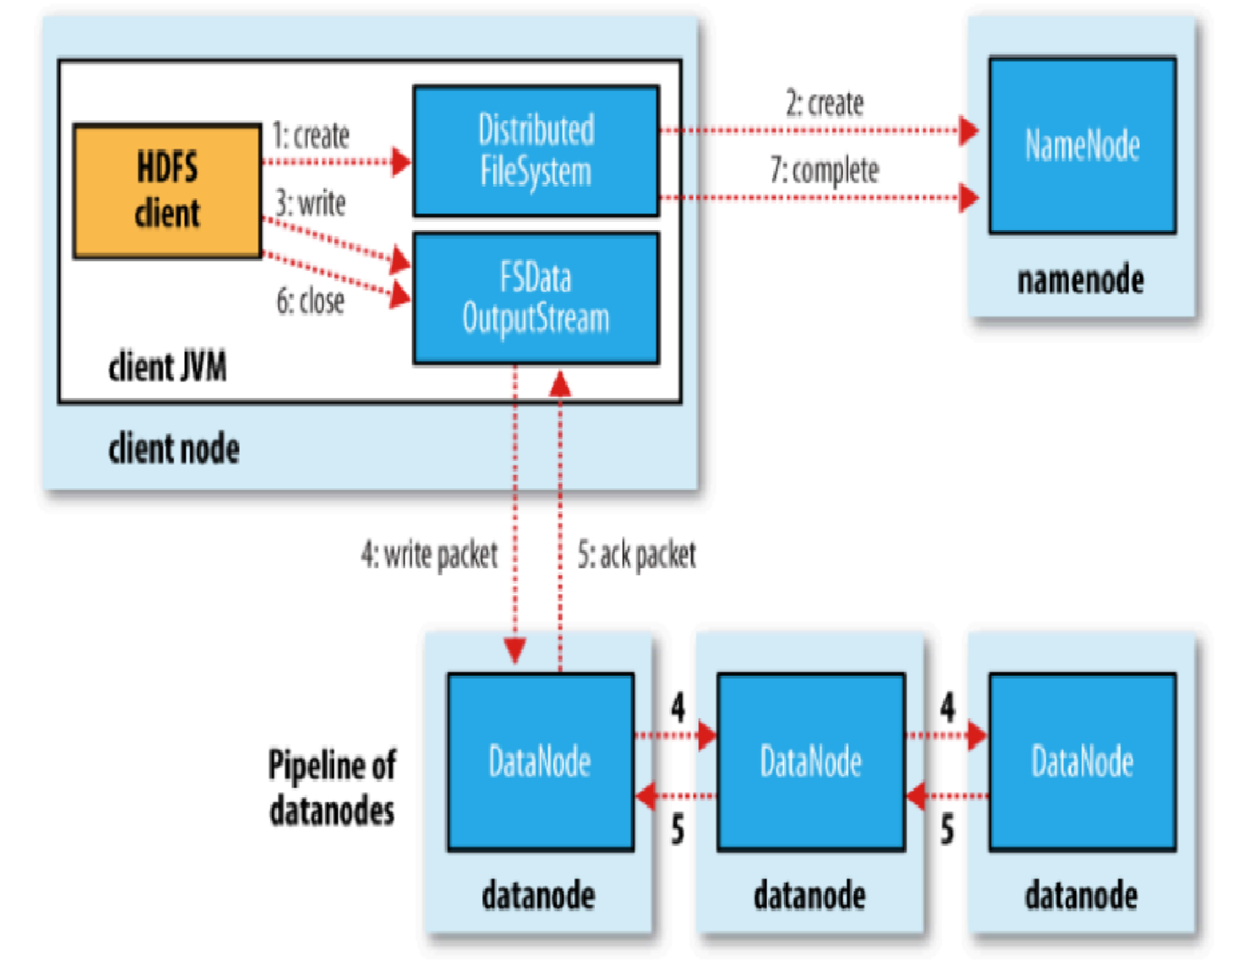
HDFS Write
Notes:
Reference: “The Hadoop Definitive Guide”, Tom White

Slide 31
Write Operation
Block allocation
Hflush operation
Renewal of lease
Lease – soft limit, hard limit
Single-writer multiple-reader model

Slide 32
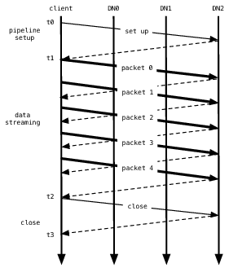
Data pipeline during block construction
Notes:
Reference: “The Hadoop Distributed File System”, K. Shvachko, H. Kuang, S. Radia, R. Chansler

Slide 33
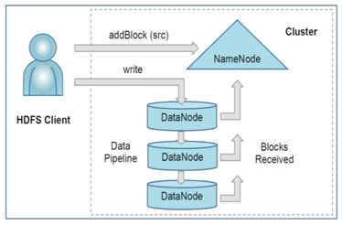
Creation of new file
Notes:
Reference: “The Hadoop Distributed File System”, K. Shvachko, H. Kuang, S. Radia, R. Chansler

Slide 34
Read Operation
Checksums
Verification

Slide 35
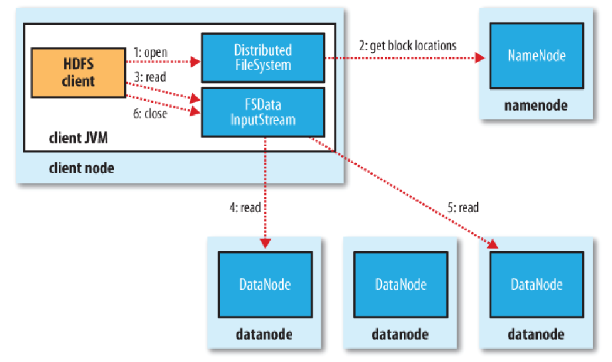
HDFS Read
Notes:
Reference: “The Hadoop Definitive Guide”, Tom White

Slide 36
Replication
Multiple nodes for reliability
Additionally, data transfer bandwidth is multiplied
Computation is near the data
Replication factor

Slide 37
Image and Journal
State is stored in two files:
fsimage: Snapshot of file system metadata
editlog: Changes since last snapshot
Normal Operation:
When namenode starts, it reads fsimage and then applies all the changes from edits sequentially

Slide 38
Snapshots
Persistently save current state
Instruction during handshake

Slide 39
Block Placement
Nodes spread across multiple racks
Nodes of rack share a switch
Placement of replicas critical for reliability

Slide 40
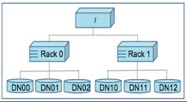
Notes:
Reference: “The Hadoop Distributed File System”, K. Shvachko, H. Kuang, S. Radia, R. Chansler

Slide 41
Replication Management
Replication factor
Under-replication
Over-replication

Slide 42
Balancer
Balance disk space usage
Optimize by minimizing the inter-rack data copying

Slide 43
Block Scanner
Periodically scan and verify checksums
Verification succeeded?
Corrupt block?

Slide 44
Decommisioning
Removal of nodes without data loss
Retired on a schedule
No blocks are entirely replicated

Slide 45
HDFS –What does it choose in CAP
Partition Tolerance – can handle loosing data nodes
Consistency
Steps towards Availability: Backup Node
Notes:
Reference: http://stackoverflow.com/questions/19923196/cap-with-distributed-system

Slide 46
Backup Node
NameNode streams transaction log to BackupNode
BackupNode applies log to in-memory and disk image
Always commit to disk before success to NameNode
If it restarts, it has to catch up with NameNode
Available in HDFS 0.21 release
Limitations:
Maximum of one per Namenode
Namenode does not forward Block Reports
Time to restart from 2 GB image, 20M files + 40 M blocks
3 – 5 minutes to read the image from disk
30 min to process block reports
BackupNode will still take 30 minutes to failover!
Notes:
Reference: http://www.borthakur.com/ftp/hdfs_high_availability.pdf

Slide 47
Files in HDFS

Slide 48
File Permissions
Three types:
Read permission (r)
Write permission (w)
Execute Permission (x)
Owner
Group
Mode

Slide 49
Command Line Interface

Slide 50
hadoop fs –help
hadoop fs –ls : List a directory
hadoop fs mkdir : makes a directory in HDFS
copyFromLocal : Copies data to HDFS from local filesystem
copyToLocal : Copies data to local filesystem
hadoop fs –rm : Deletes a file in HDFS
More:
https://hadoop.apache.org/docs/r2.4.1/hadoop-project-dist/hadoop-common/FileSystemShell.html

Slide 51
Accessing HDFS directly from JAVA
Programs can read or write HDFS files directly
Files are represented as URIs
Access is via the FileSystem API
To get access to the file: FileSystem.get()
For reading, call open() -- returns InputStream
For writing, call create() -- returns OutputStream

Slide 52
Interfaces
Getting data in and out of HDFS through the command-line interface is a bit cumbersome
Alternatives:
FUSE file system: Allows HDFS to be mounted under Unix
WebDAV Share: Can be mounted as filesystem on many OSes
HTTP: Read access through namenode’s embedded web svr
FTP: Standard FTP interface
Notes:
Reference: http://www.cis.upenn.edu/~nets212/

Slide 53
Thank you

